Slide 1
Working With Images
Tutorial #10

Slide 2
OBJECTIVE

Slide 3
Objective
You'll walk away from this tutorial with the knowledge of how to create an image in HTML and how to manipulate it dynamically with Javascript.

Slide 4
TEXTPLANATION

Slide 5
Textplanation
We are, the human race I mean, visual creatures. Seeing is believing and all that. This is why so much of web design is focused on graphic design. Keep that in mind always. We are web developers. That means we have to have an understanding of how to manipulate the visuals in the digital environment.

Slide 6
Textplanation
At the HTML level, an image is placed onto your page using the <img /> tag. You'll see more about it in the construction, but suffice to say that it relies on an attribute called src. That attribute tells it the filename of the image. That means that you need to have the image files available for the page to read.

Slide 7
Textplanation
It’s best to stick with one of two types of images. Jpegs (.jpg) are small files that load easily into your page. The drawbacks to jpegs is that they don't support transparency. Portable Network Graphics images (.png) are a little bigger, but they do support transparency.

Slide 8
Textplanation
I like PNGs.

Slide 9
CONSTRUCTION

Slide 10
Construction
A zip file is associated with this tutorial.
It has a directory structure with some images in it.
Unzip it into a folder called Working With Images and put your construction there.
Open up notepad++.
Save the empty file to your folder and name the file “index.html”.
All first pages on a website are called index.
As you go through the images of the construction, add to your code. You will see comments with explanations of what you are doing. Those comments will change with each slide. You should not type my comments into your code.

Slide 11
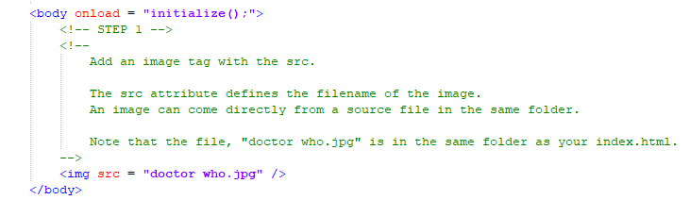
Construction

Slide 12
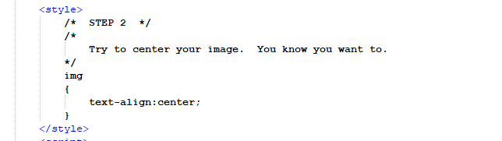
Construction

Slide 13
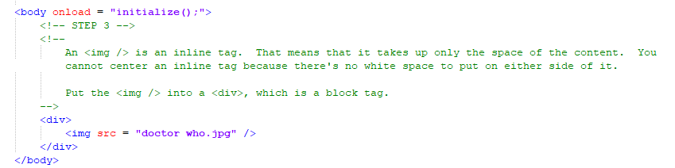
Construction

Slide 14
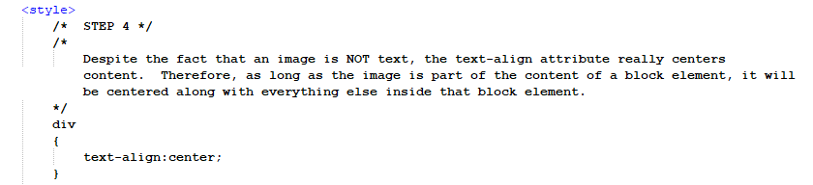
Construction

Slide 15
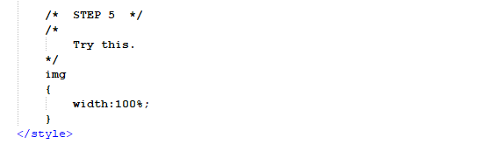
Construction

Slide 16
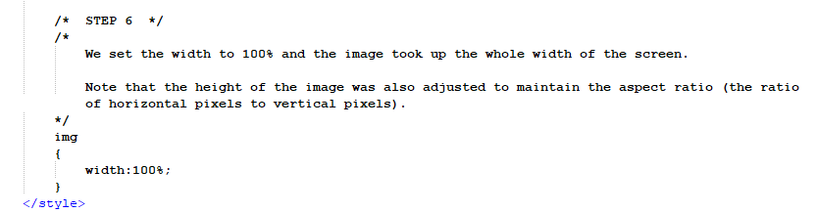
Construction

Slide 17
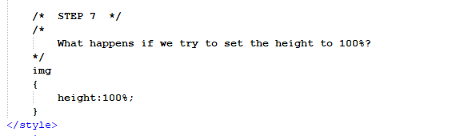
Construction

Slide 18
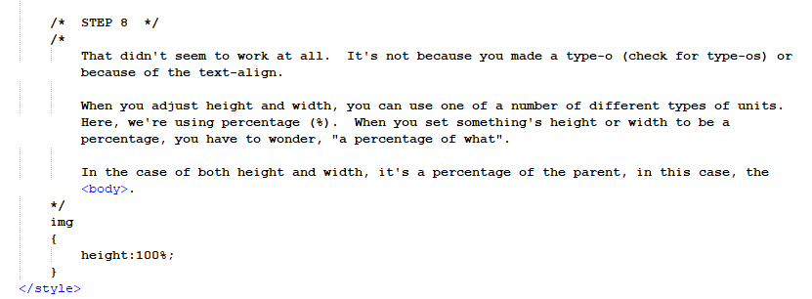
Construction

Slide 19
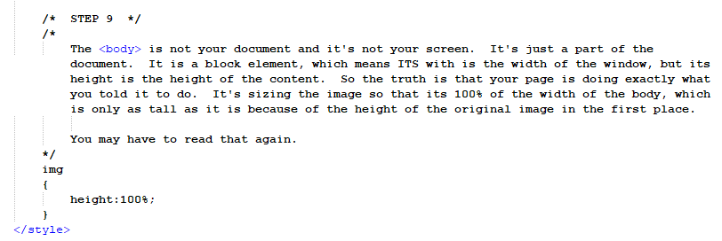
Construction

Slide 20
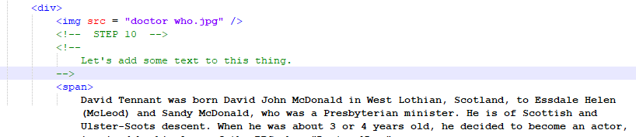
Construction
All of the text is available on the next slide for copying and pasting.

Slide 21
Construction
David Tennant was born David John McDonald in West Lothian, Scotland, to Essdale Helen (McLeod) and Sandy McDonald, who was a Presbyterian minister. He is of Scottish and Ulster-Scots descent. When he was about 3 or 4 years old, he decided to become an actor, inspired by his love of the BBC show "Doctor Who."
He was brought up in Bathgate, West Lothian and Paisley, Renfrewshire, Scotland and was a huge fan of the band The Proclaimers. He attended Paisley Grammar school and while there he wrote about how he wanted to become a professional actor and play the role of the Doctor in "Doctor Who."
He made his first television appearance (which was also his first professional acting job) when he was 16, after his father sent some photos of him to a casting director at Scottish television. He also attended a youth theatre group at weekends run by the Royal Scottish Academy of Music and Drama (RSAMD - now renamed the Royal Conservatoire of Scotland [RCS]). When he was 16 he auditioned for and won a place at the RSAMD; the youngest student to ever do so, and started as a full time drama student when he was 17.
He worked regularly in theatre and TV after leaving drama school, and his first big break came in 1994 when he was cast in a lead role in the Scottish drama "Takin' Over the Asylum." He then moved to London where his career thrived. Amongst other things, he spent several years as a member of the Royal Shakespeare Company, and became famous from his lead roles in TV dramas "Blackpool" and "Casanova."
In 2005, his childhood wish came true. David was cast to play the role of the Doctor in the BBC'S new series of "Doctor Who" alongside Billie Piper, after Christopher Eccleston decided to leave. Playing the Doctor made him a household name. Since leaving Doctor Who in 2010 his career has continued to rise, with lead roles in films, TV series and theatre.

Slide 22
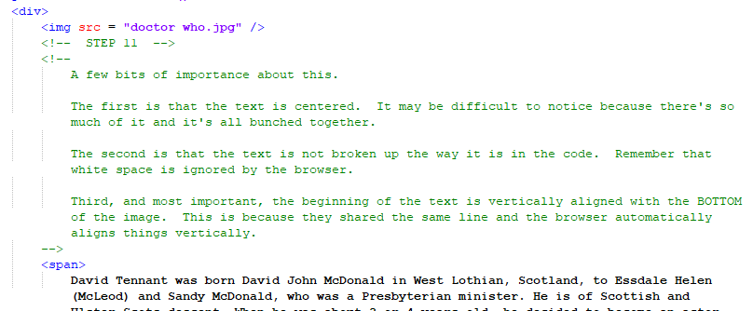
Construction

Slide 23
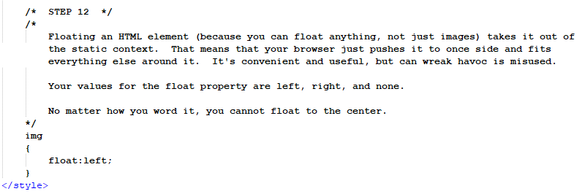
Construction

Slide 24
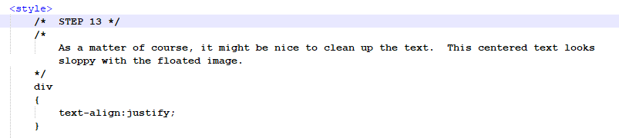
Construction

Slide 25
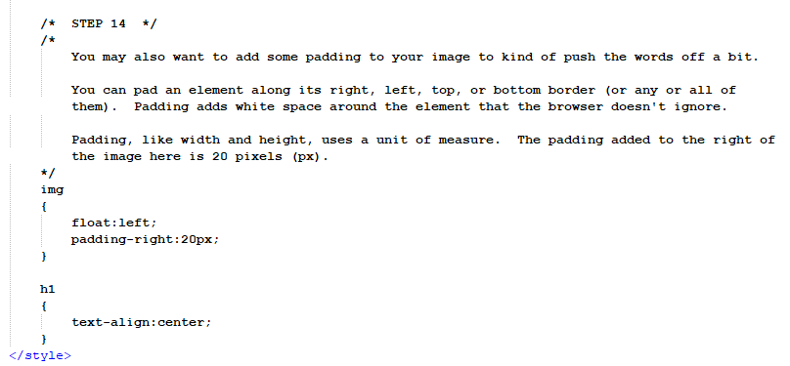
Construction

Slide 26
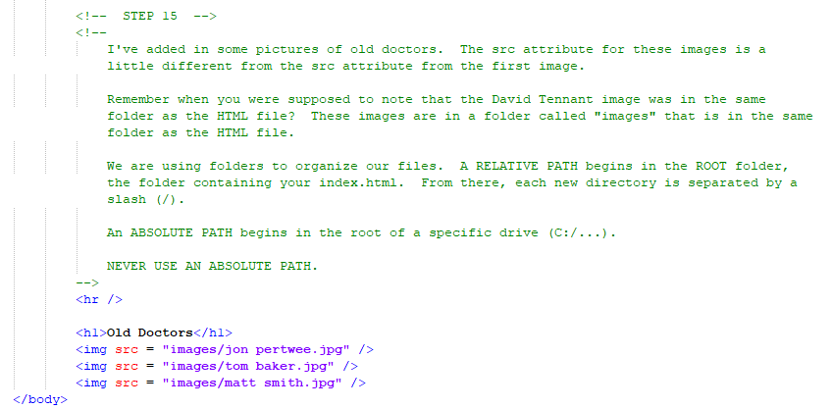
Construction

Slide 27
A DEEPER MEANING

Slide 28
A Deeper Meaning
We're running client side pages on our local machine. When a website is published, it’s uploaded to a server. The user or client or person sitting at the computer downloads your page to his or her machine. So, to recap, every website you visit when you're sitting at home in your pajamas, munching on devil dogs and stale chips is actually on your computer.

Slide 29
A Deeper Meaning
In order for this to work, you need to set up a directory structure for all of your files so that the page knows where to look when it wants to load, say, an image. A path consists of the chain of file folders leading all the way down to your file. An absolute path starts with the drive letter. A relative path starts with a root directory.

Slide 30
A Deeper Meaning
By the way, the word directory is synonymous with the word folder.

Slide 31
A Deeper Meaning
All of the available drives on your computer have a letter. The hard drive is usually C and the DVD drive, if you have one, is usually D. Flash drives and other types of storage are given letters on the fly. A typical absolute path may look like:
C:/folder1/folder2/mypage.html

Slide 32
A Deeper Meaning
That's your page on your drive.

Slide 33
A Deeper Meaning
That path does not exist on any other computer. So, if you tell the page that your image file is down that particular path, it’s only going to be able to find it when it’s running on your computer.

Slide 34
A Deeper Meaning
That's why we stick with relative paths. In the construction, we put just the image name into the src attribute. And the image file was in the same folder as the HTML file. That will work on any machine because it uses a relative path.

Slide 35
A Deeper Meaning
A relative path starts with a root. The root is basically wherever your file is. So, when you specify just a filename, the page assumes it’s in the root. If you were to put something like this:
src = “images/myimage.png”
It would look for a folder in the root called images and a file in images called myimage.png. Since the root is dynamic, you can set up whatever kind of directory structure you like.

Slide 36
FAQ

Slide 37
FAQ
Is the root where my index.html is?
No. The root is dynamic. When the browser opens a page, any page, the root is the folder where that page resides.

Slide 38
FAQ
How can I access files in a parent folder?
Use the .. notation. For example, if I was in a file in a subdirectory and I needed to access something above it, I would write: ../thefile.ext.

Slide 39
ACTIVITY

Slide 40
Image Gallery
An image gallery is a page that has a series of small “thumbnail” images and a single large image. Whenever the user clicks on one of the thumbnails, the large image is replaced with a larger version of the thumbnail.
Find a few images online and organize them into thumbnails on a web page.
Create another image element for you large image and set its src to the first of your thumbnails.
Each time the user clicks on one of the thumbnails, change the src of the large image to match the src of the clicked thumbnail.

Slide 41
Image Gallery
In order to dynamically change the src of an image, you will need to have it stored in a Javascript object (like we do with divs and spans, etc…).
The src can be accessed by using the dot.
myImage = document.getElementById(…);
myImage.src = …..;

